Slide 1
PBL Presentation
Title
Presented By
Under the guidance of
----------------------
Prof Swetha M S
Asst Professor/ Dept of ISE
BMSIT&M
Mr. XXX USN:1BY1xISXXX
Ms. XXX USN:1BY1xISXXX
Mr. XXX USN:1BY1xISXXX Mr. XXX USN:1BY1xISXXX

Slide 2
CONTENTS
Introduction
Motivation
Literature Survey (if any)
Existing System
Proposed System
Problem Statement
Relevance to Society/Industry
Project Schedule and Budget
Tools Used (Software/Hardware)
Methodology (Use case/DFD/Flow Diagram)
Results(Screenshots)
Conclusion
Any certified course done provide certificate
References

Slide 3
INTRODUCTION
Only bullet points

Slide 4
MOTIVATION
Only bullet points

Slide 5
Literature Survey
SL no | PAPER TITLE | PUBLICATIONS (Journal name, Vol, Issue,year) | METHODOLOGY | LIMITATIONS | GAPS IDENTIFIED
1
2

Slide 6
EXISTING SYSTEMS
Bulletin points
XX
XX

Slide 7
PROPOSED SYSTEM
Points

Slide 8
PROBLEM DESCRIPTION
In bullets

Slide 9
RELEVANCE TO SOCIETY/INDUSTRY
In bullets

Slide 10
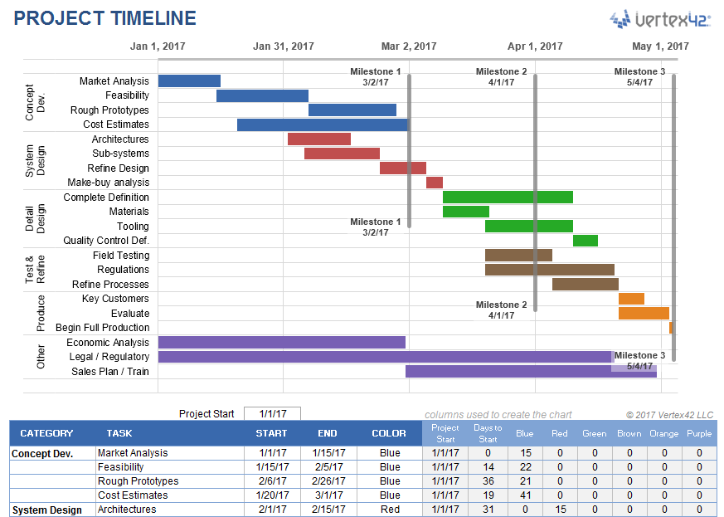
PROJECT SCHEDULE
In bullets

Slide 11
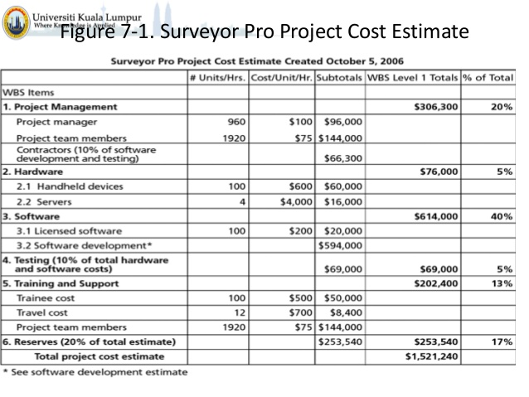
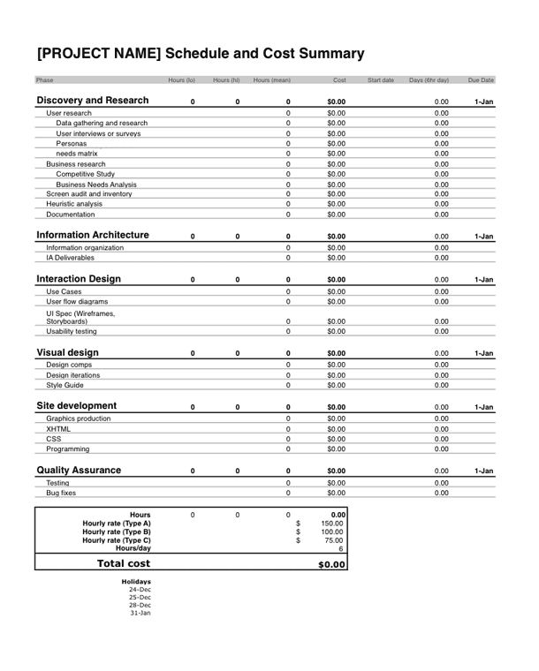
COST ESTIMATION

Slide 12
TOOLS USED
HARDWARE
System : Pentium IV 2.4 GHz.
Hard Disk : 40 GB.
Monitor : 15 VGA Colour.
Mouse : In-built
Ram : 512 Mb Minimum
SOFTWARE
Operating system : Windows XP/ Windows 7 or More
Software Tool : Tensorflow 1.14 , Open Cv
Coding Language : Python.
Toolbox : Image processing toolbox.
Data Base :

Slide 13
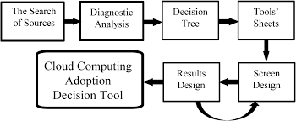
METHODOLOGY

Slide 14
IMPLEMENTATION
SAMPLE CODE/ LINK TO CODE

Slide 15
RESULTS
Screen shots of your implementation
.

Slide 16
CONCLUSION
BULLET POINTS
.

Slide 17
FUTURE ENHANCEMENT
BULLET POINTS
.

Slide 18
Any Certified course completed showcase the certificate

Slide 19
REFERENCES
Dzmitry Bahdanau, Kyunghyun Cho, and Yoshua Bengio. “Neural machine translation by jointly learning to align and translate” arXiv:1409. 0287g9 ICLR 19th may 2016.
.

